Slide 1
Project Turing

Slide 2
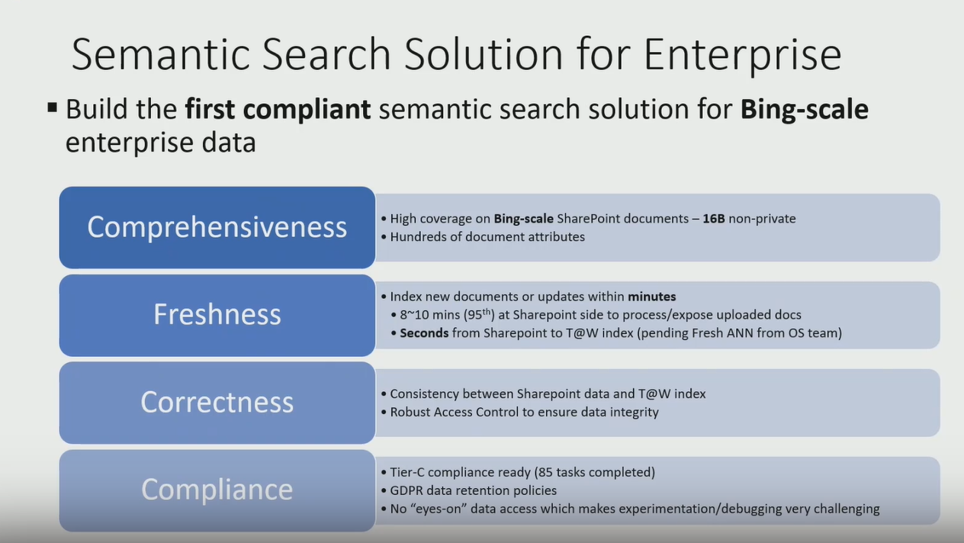

Slide 3
Num private
Index sharepoint/document/attributes
View counts
How many updates
Document owner/comments/
Rob Connon
re-index → T@W index – partner Fresh ANN from os team
8. Consistency between SharePoint data and T@W index
9. Robust access control to ensure data integrity
Tier –C Compliance ready
GDPR
Eyes-on data access which make experimentation/debugging very challenging – Design principle

Slide 4
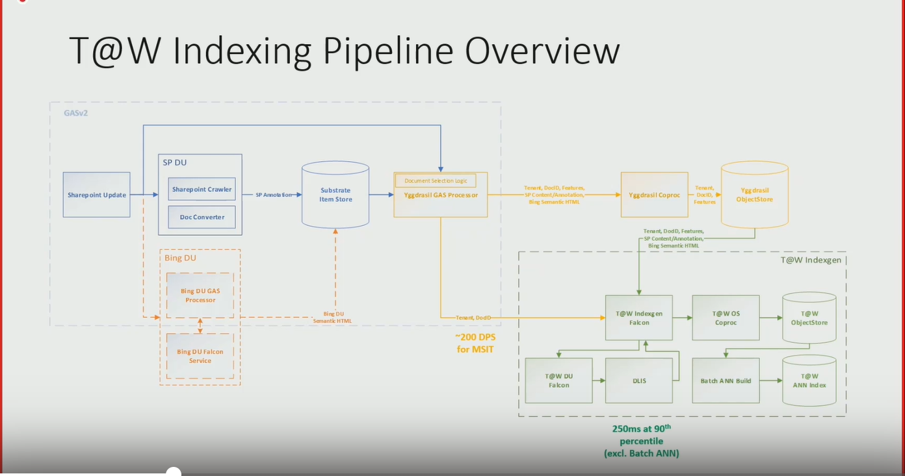

Slide 5
SharePoint -- Gas processor - -Sharepoint home / Training home/Num private
Yggdrasil GAS Processor
Zoom for improvement
Bing DU

Slide 6
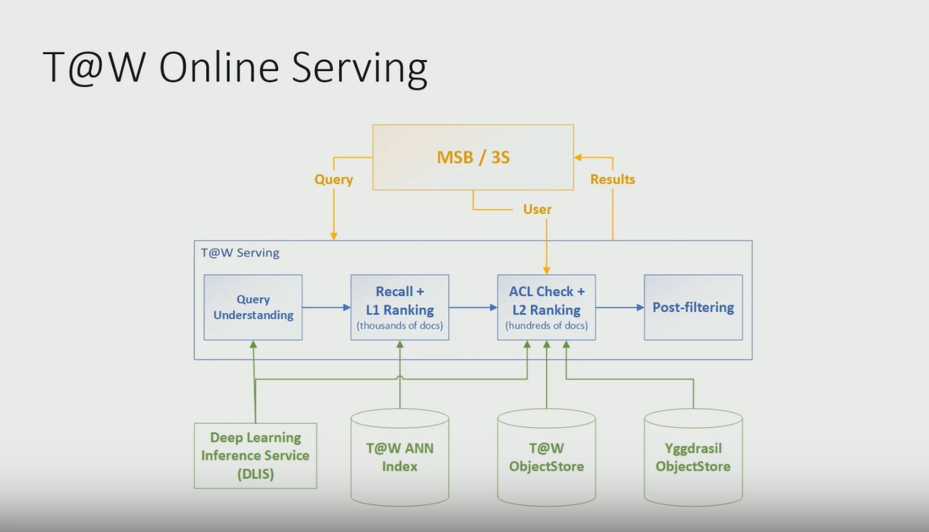

Slide 7
Query – understanding – Deep Learning Inference Service
Recall ANN – T@W ANNIndex
ACL Check – ObjectStore
Post-filtering – Yggdrasil – object Store
VM /Vector/Inverted Index/Vector represenintg the ANN/Multiple vector for the document
Vector based search – expensive
Index based search sidebar
Echo
Design coulb be have better
Offloading ACL check?

Slide 8
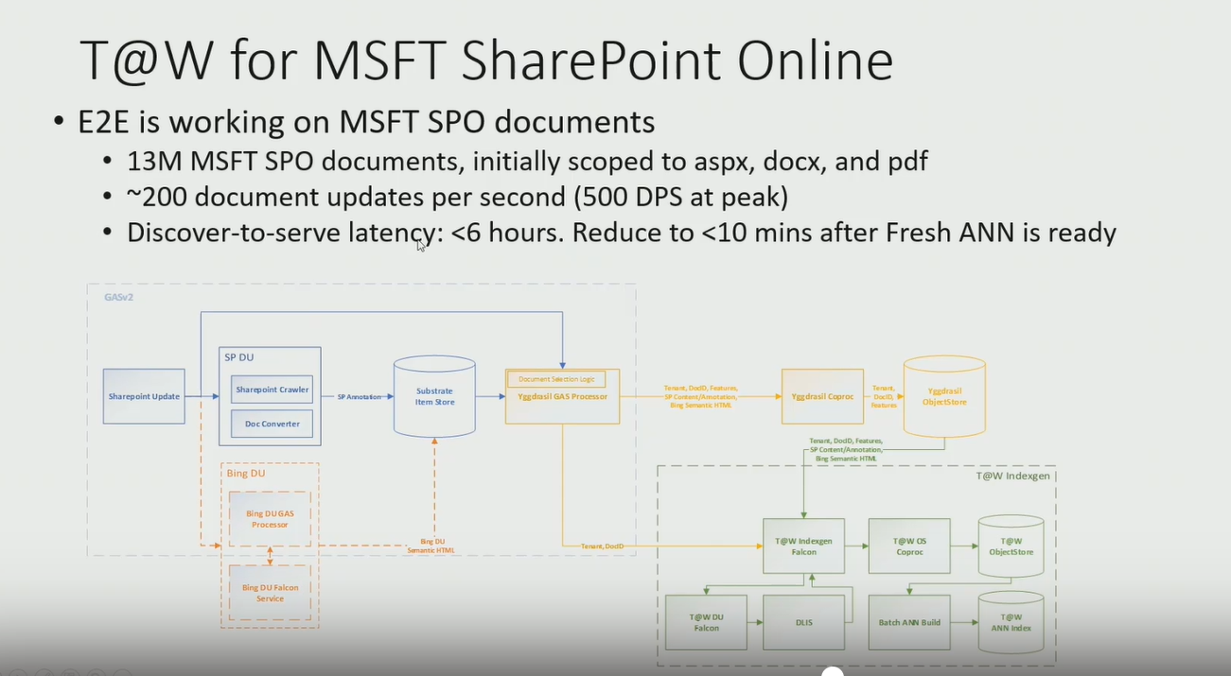

Slide 9
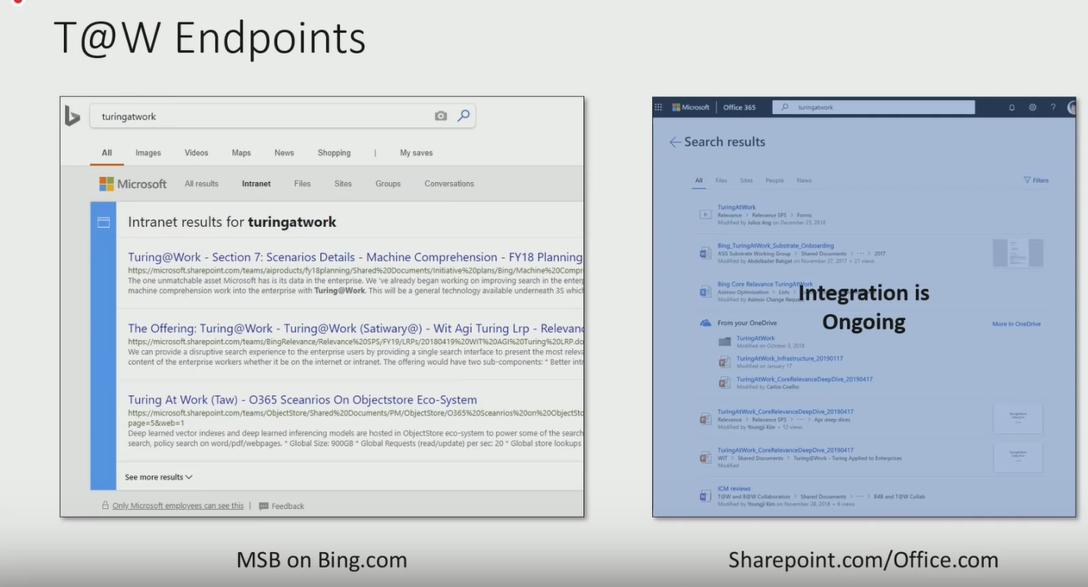

Slide 10
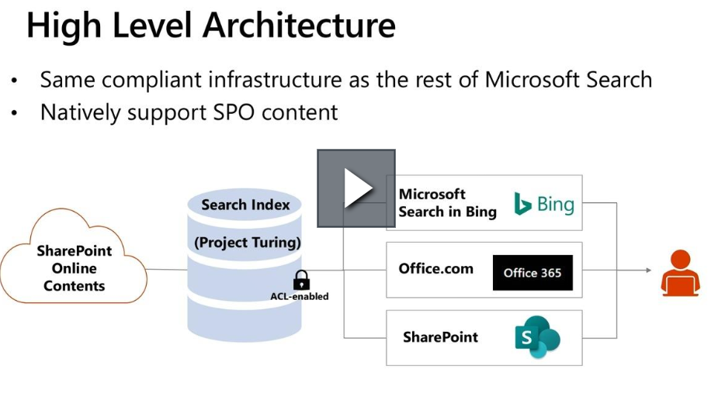

Slide 11
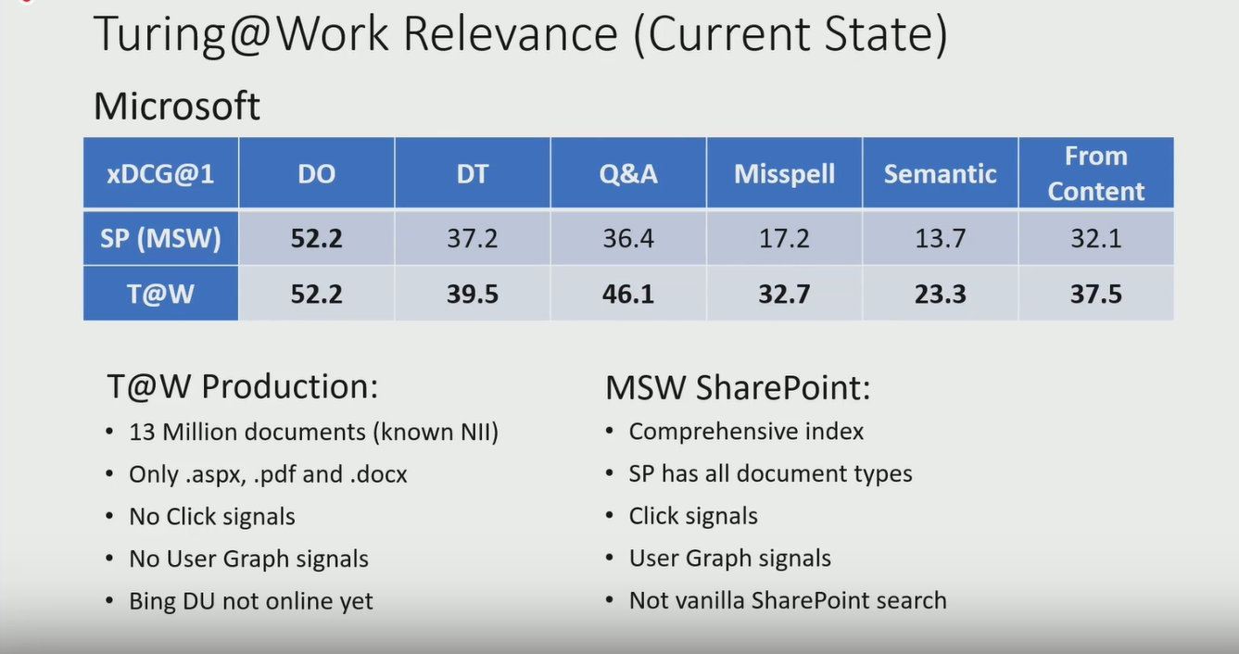

Slide 12
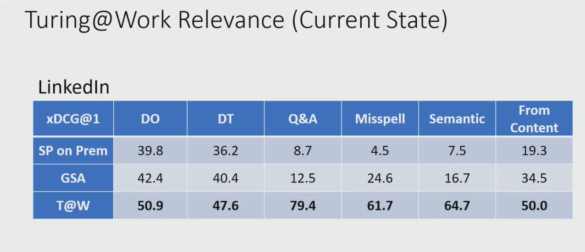

Slide 13
Google pick query
Data processing
RL Library
Ray – asynchronous creating
Apache parkway
Spark on Cosmos -- To find a contact that can help with setting it up
NLP and Bot – Dec 2018
Microsoft AI/NLP+ Bot – deep learning models.
Robert
Avoid training large model in the PG
Two hour problems
Multi-model t
MSI/Apply in the use case

Slide 14
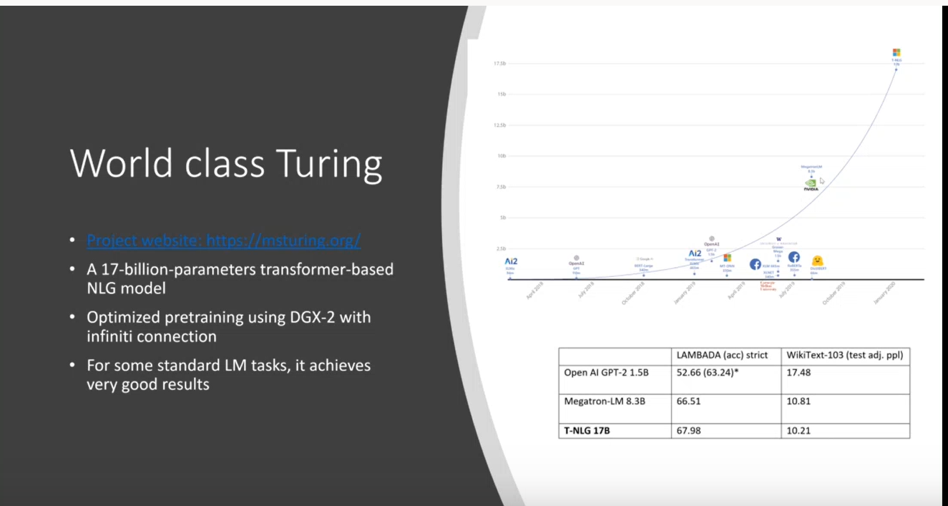

Slide 15
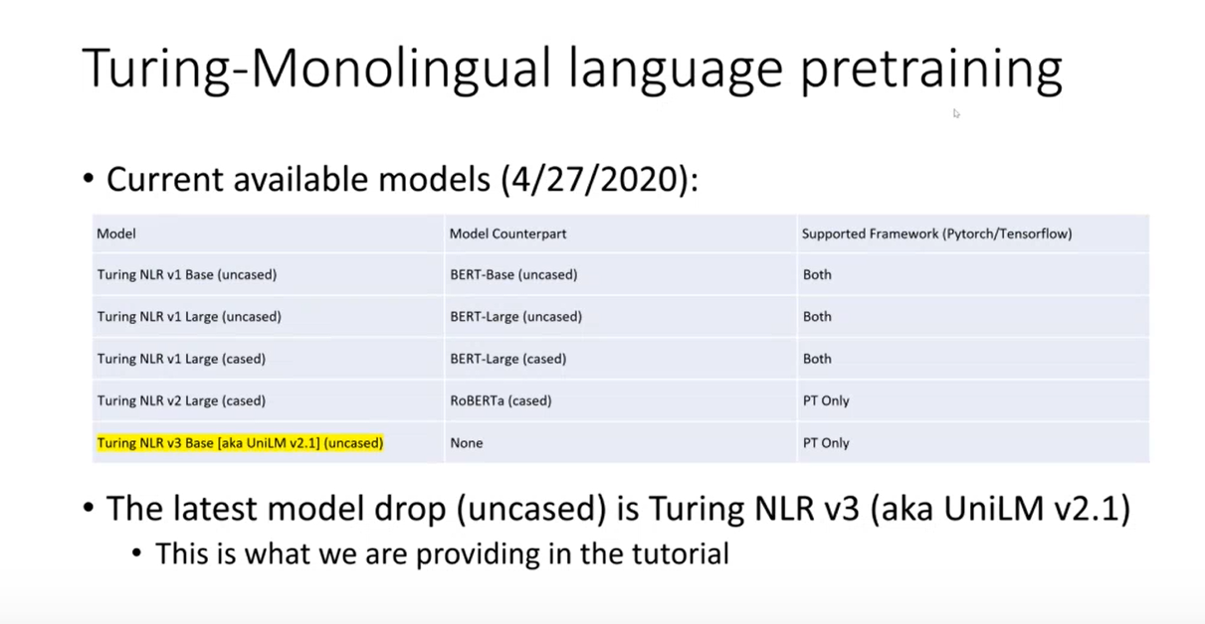

Slide 16
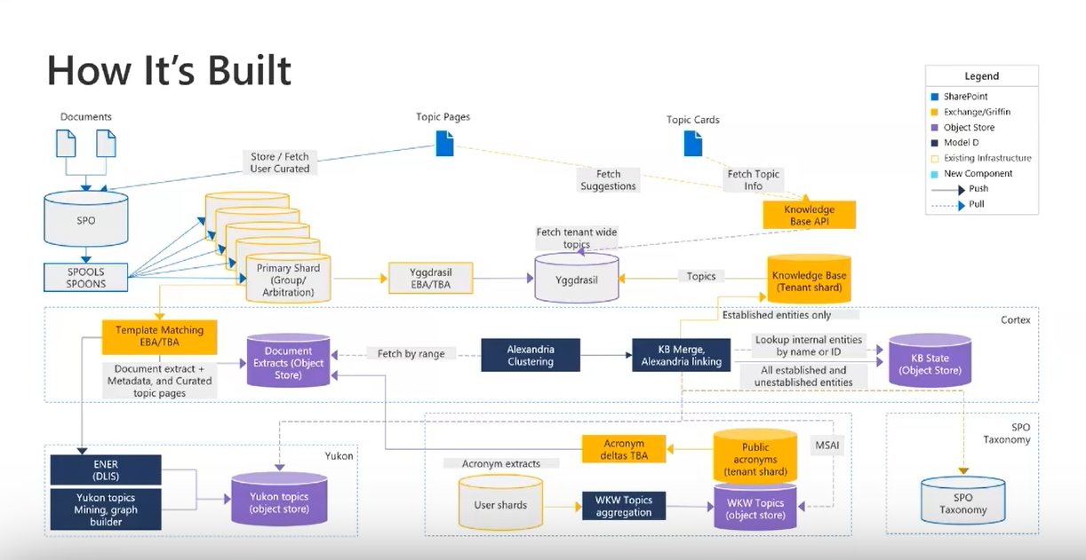

Slide 17
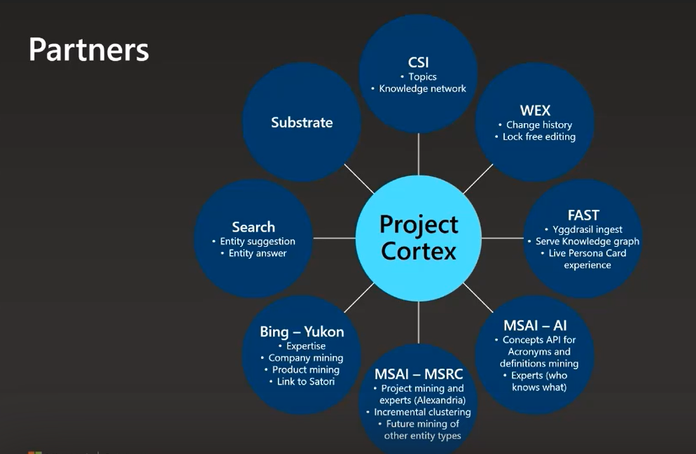

Slide 18
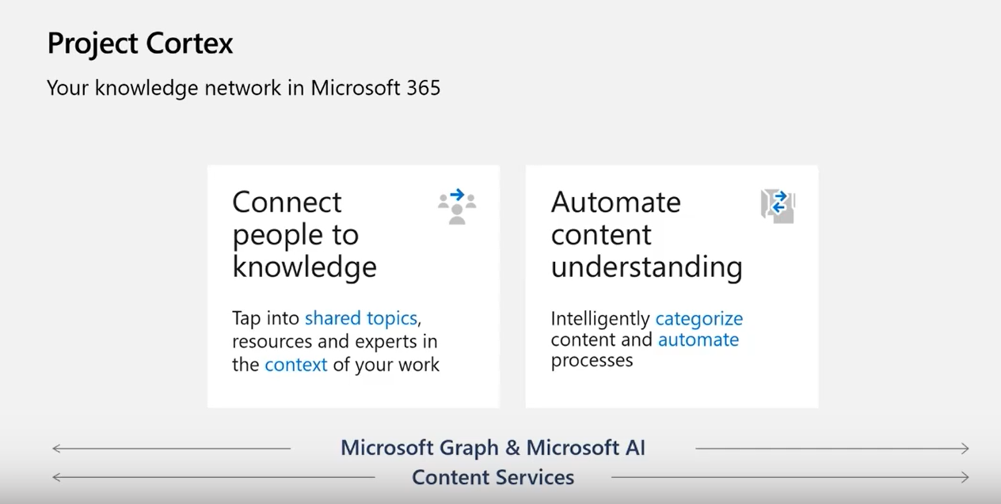

Slide 19
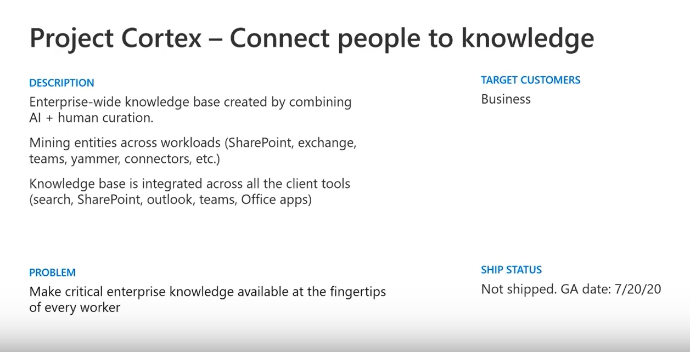

Slide 20
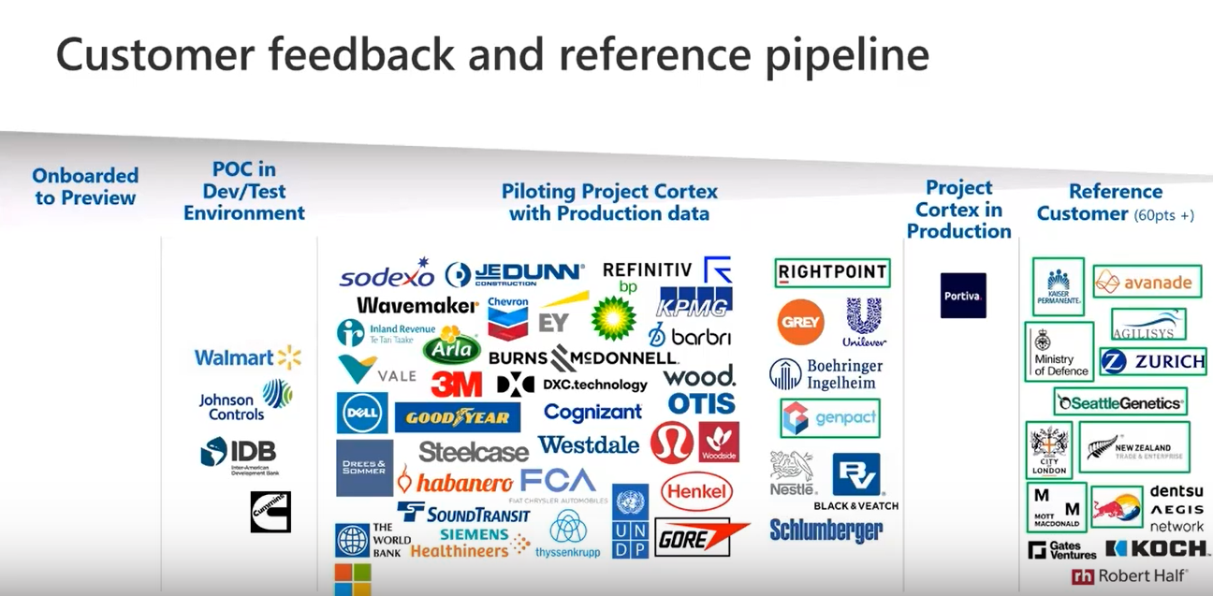

Slide 21
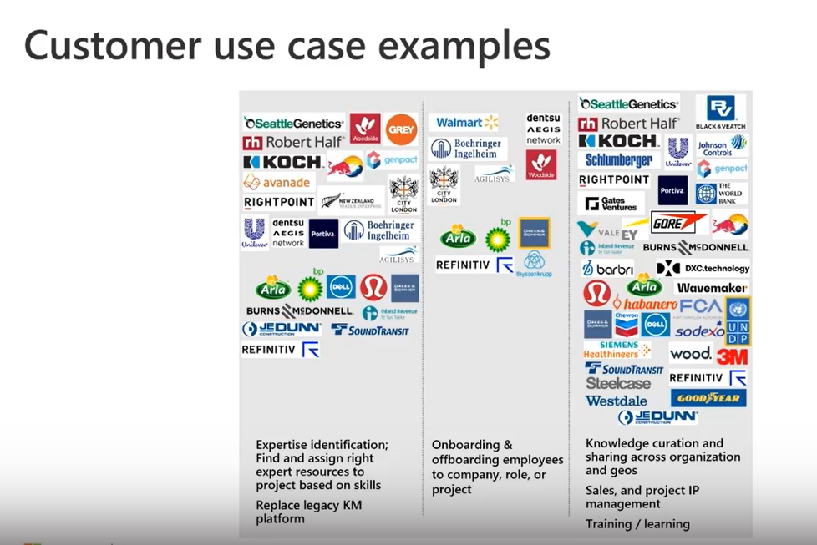

Slide 22
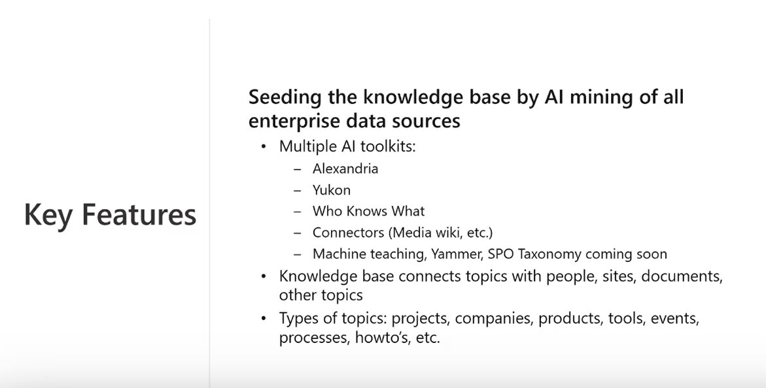

Slide 23
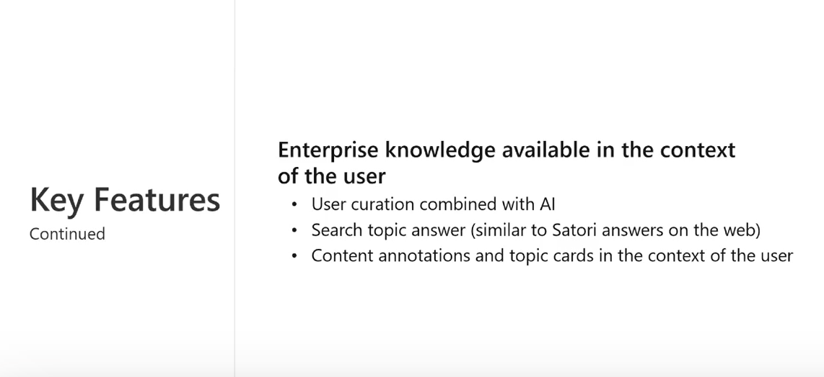

Slide 24
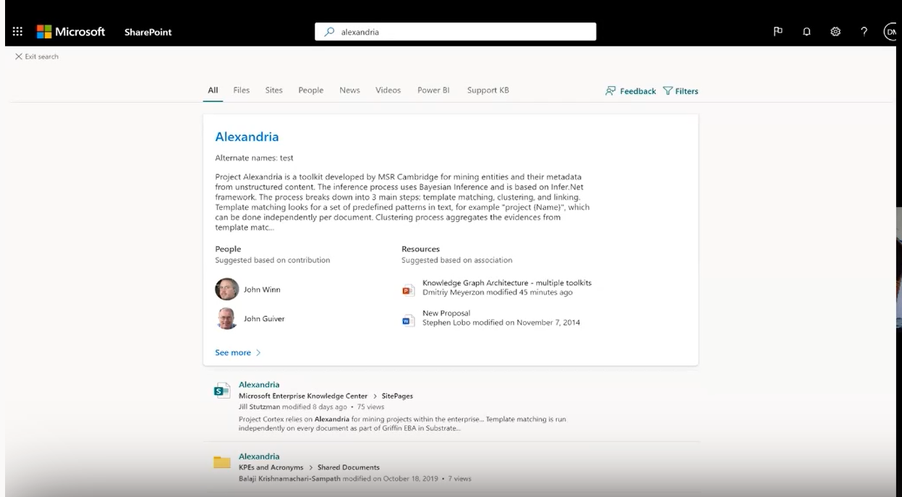

Slide 25
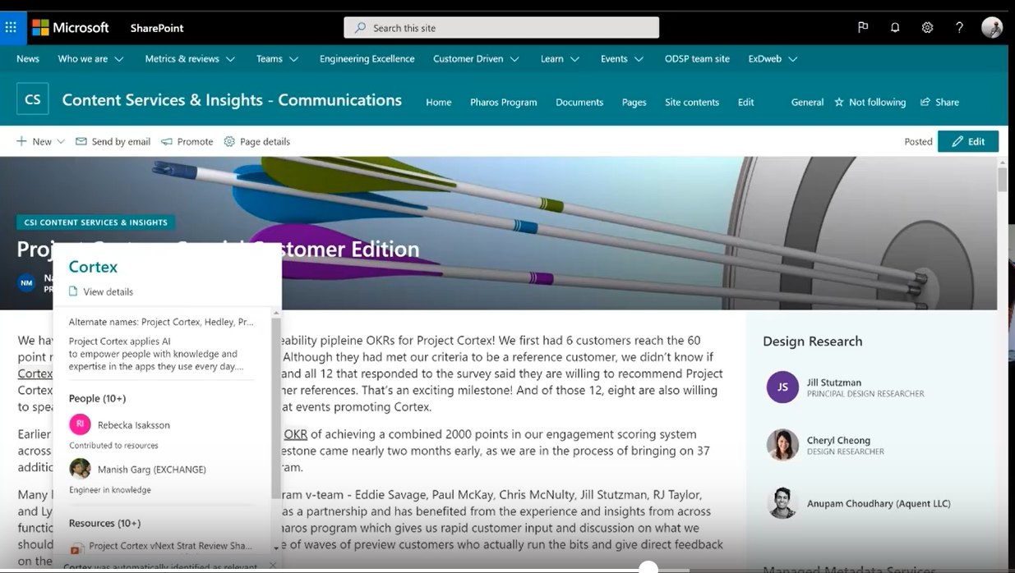

Slide 26
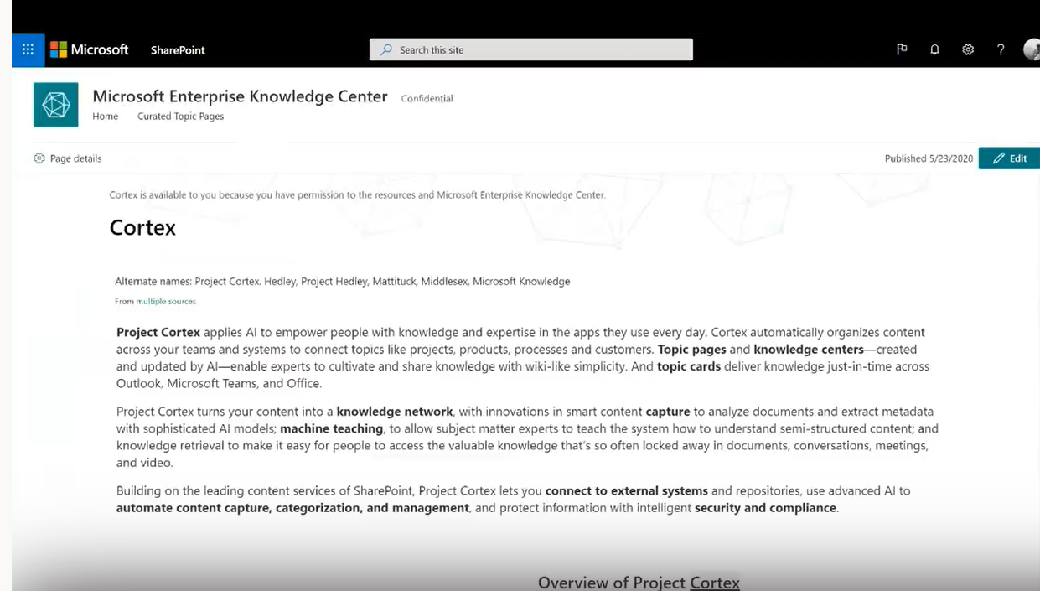

Slide 27
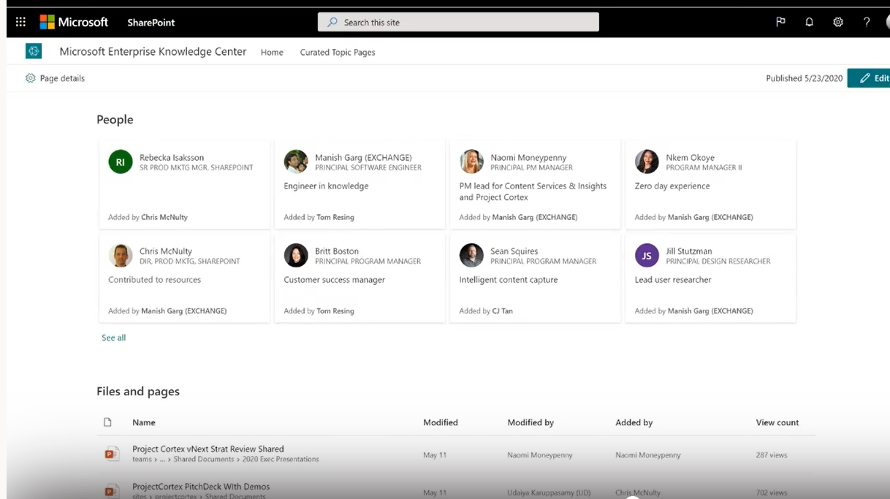

Slide 28
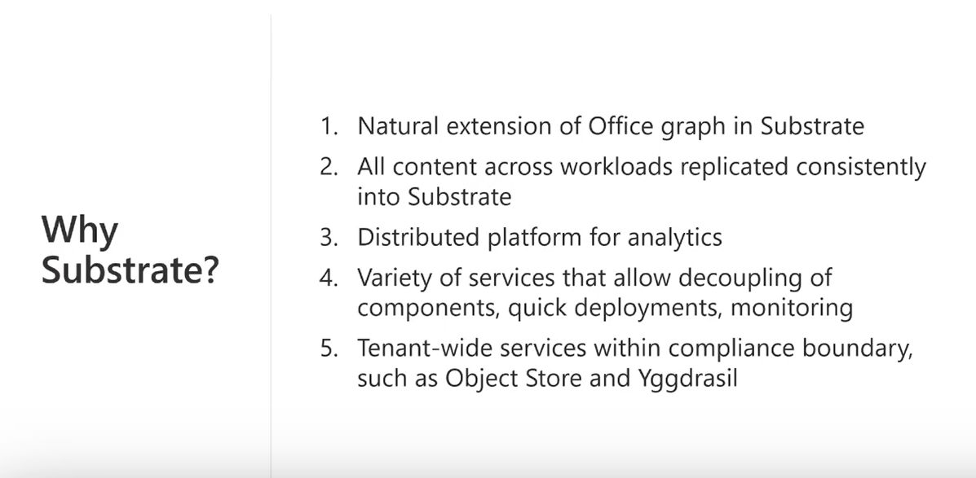

Slide 29
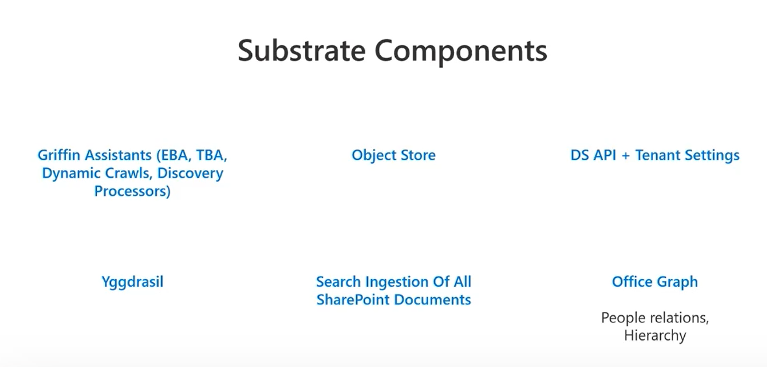

Slide 30
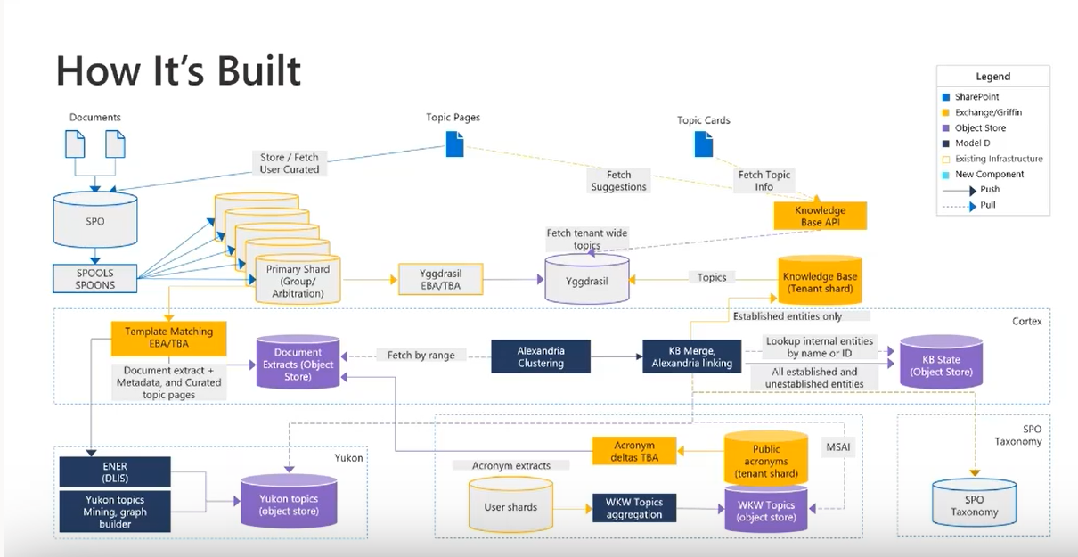

Slide 31
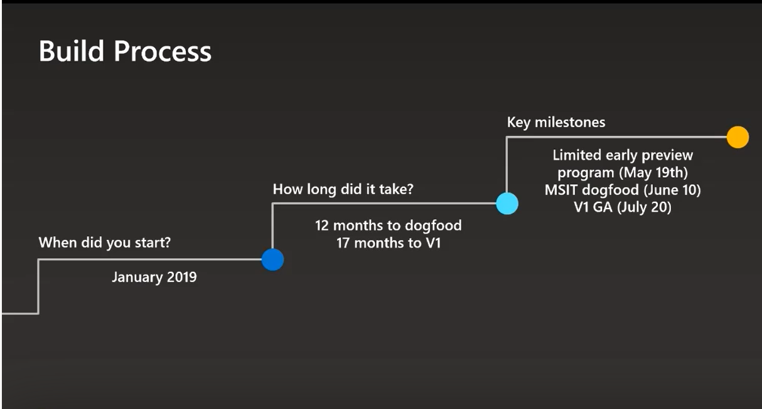

Slide 32
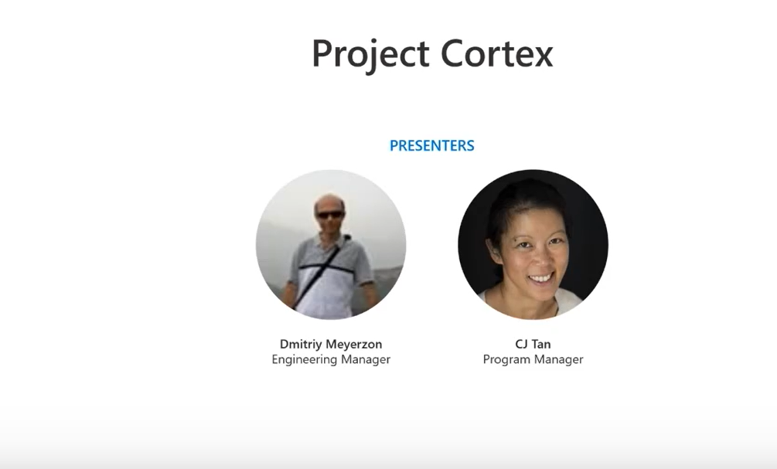

Slide 33
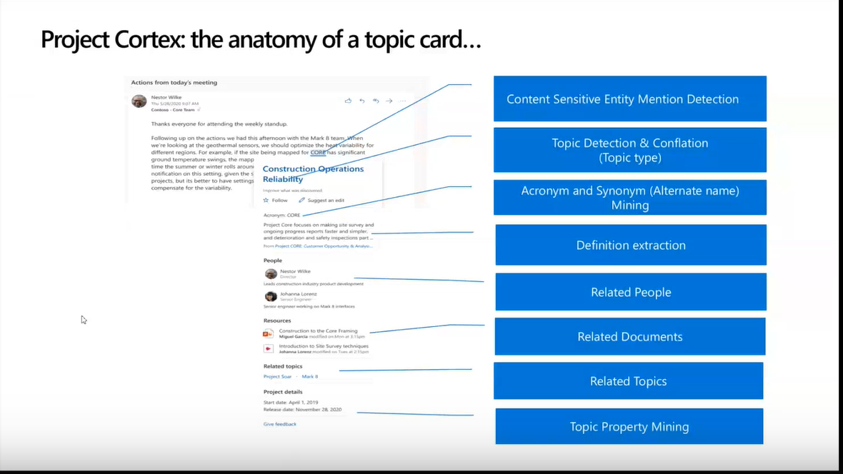

Slide 34
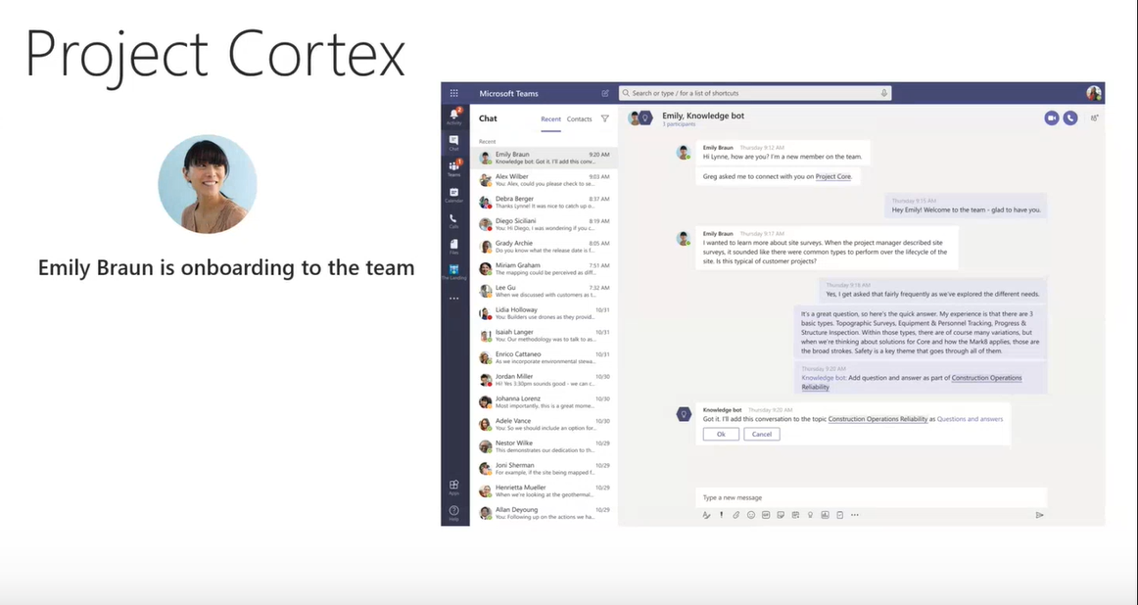

Slide 35
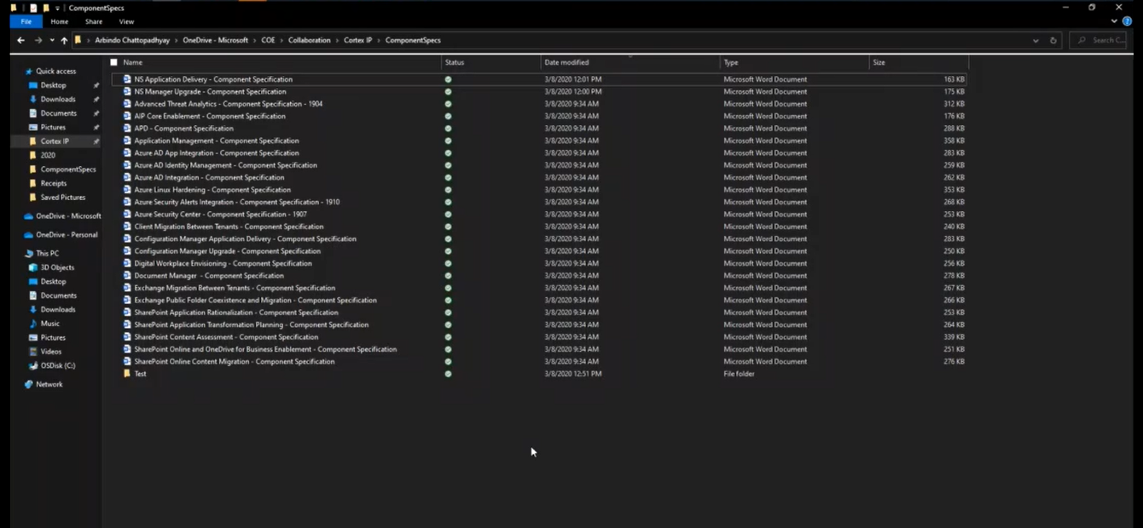

Slide 36
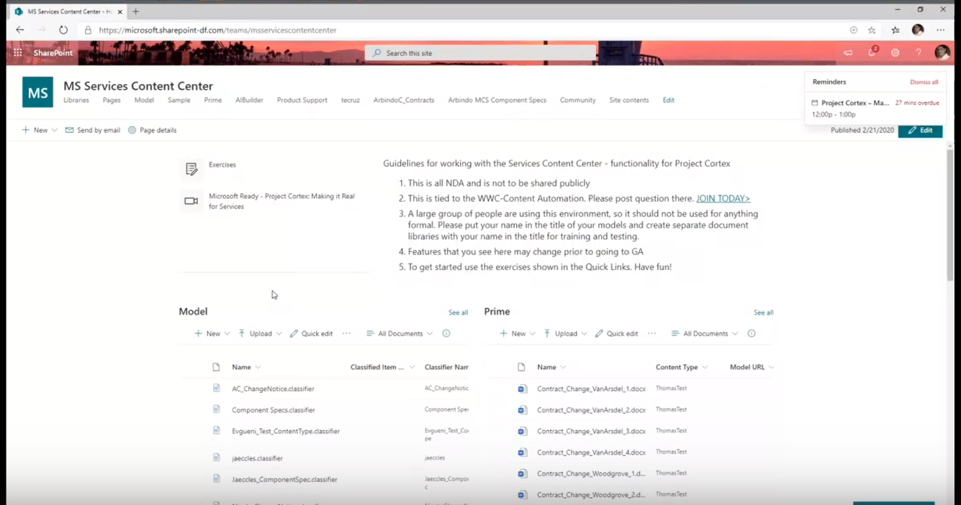

Slide 37
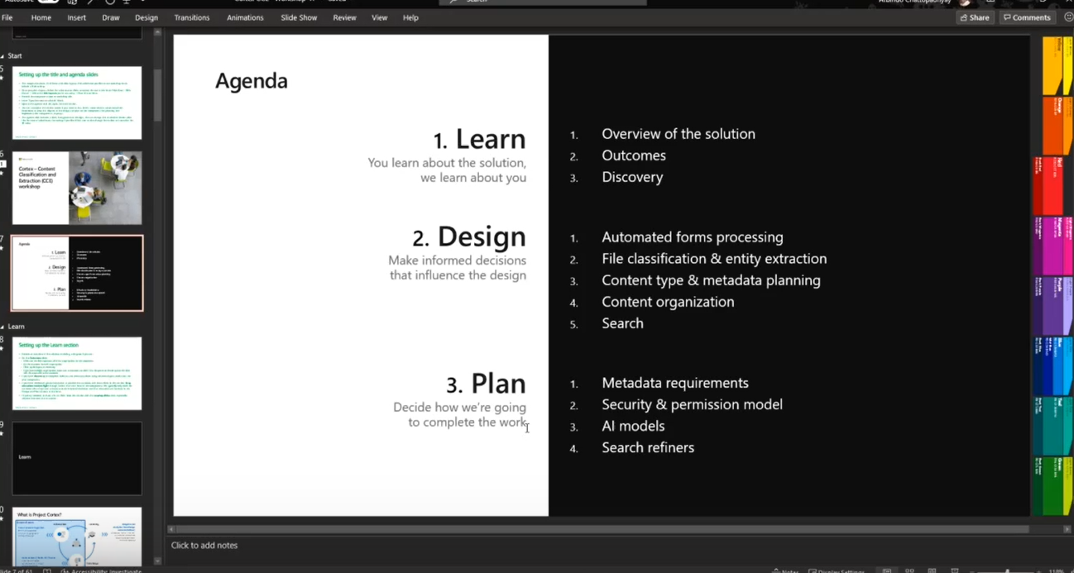

Slide 38
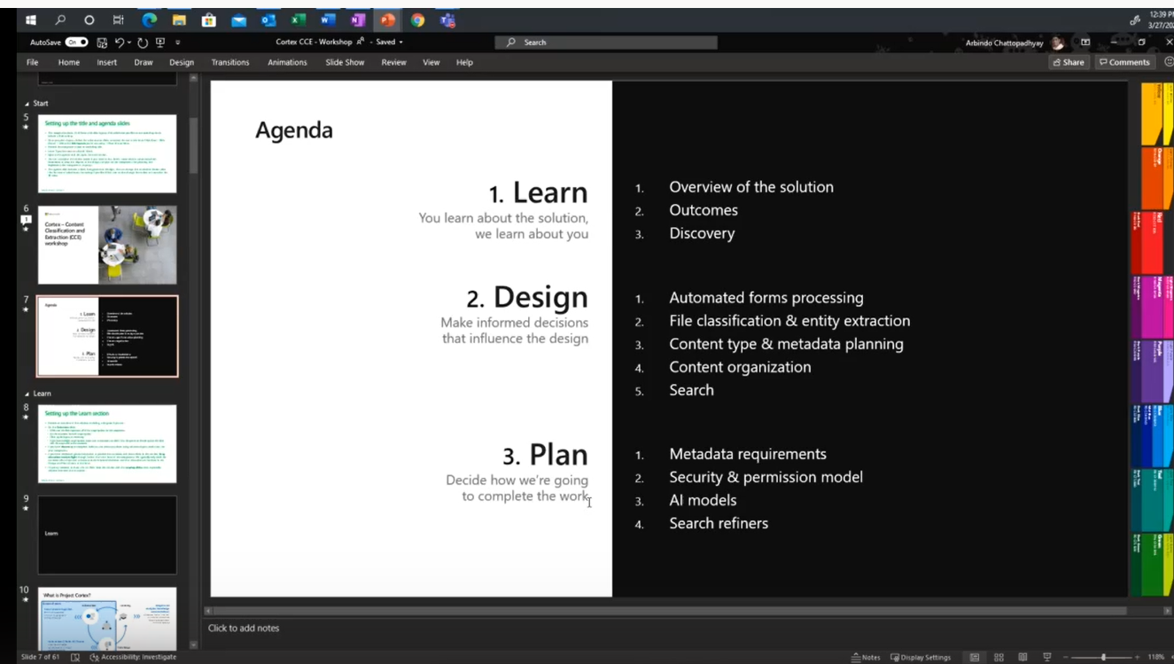

Slide 39
